Slide 1
Self Driving RC Car
Ethan Wells
Abigail Duran
Ethan Bishop
Alexis Perez

Slide 2
Ethan Wells
Goals for the week
  Prepare the LISA dataset (US traffic signs) for training.
  Test the trained German-sign (GTSRB) model.
Progress for the week
  Downloaded the LISA Traffic Signs dataset from the Kaggle mirror (the UCSD host was down).
  Wrote prepare_lisa.py: validates the download, crops each annotated sign, and splits the crops into TensorFlow-ready train/validation/test folders.
  Narrowed the 47 LISA classes to the 12 the car needs: 6,097 crops, split 4,946 / 567 / 584.
  Kept every frame of the same physical sign in one split, so near-identical images can't leak between training and testing.
  Documented the download and preparation steps in LISA_PREPARATION.md.
  Tested the GTSRB model on the 12,630-image GTSRB test set: 95.8% accuracy.
Goals for next week
  Train and test a CNN on the prepared LISA dataset.
Hours spent on progress
  7 hours.

Slide 3
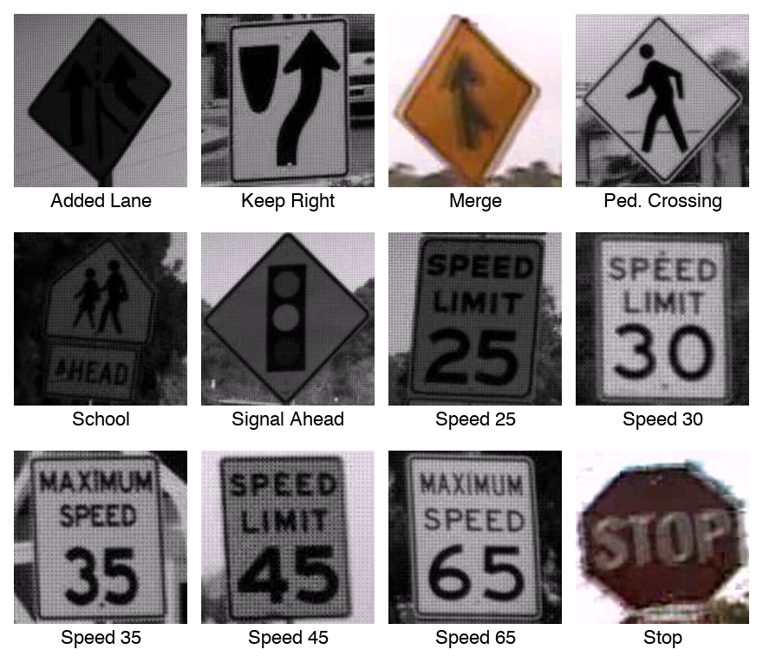
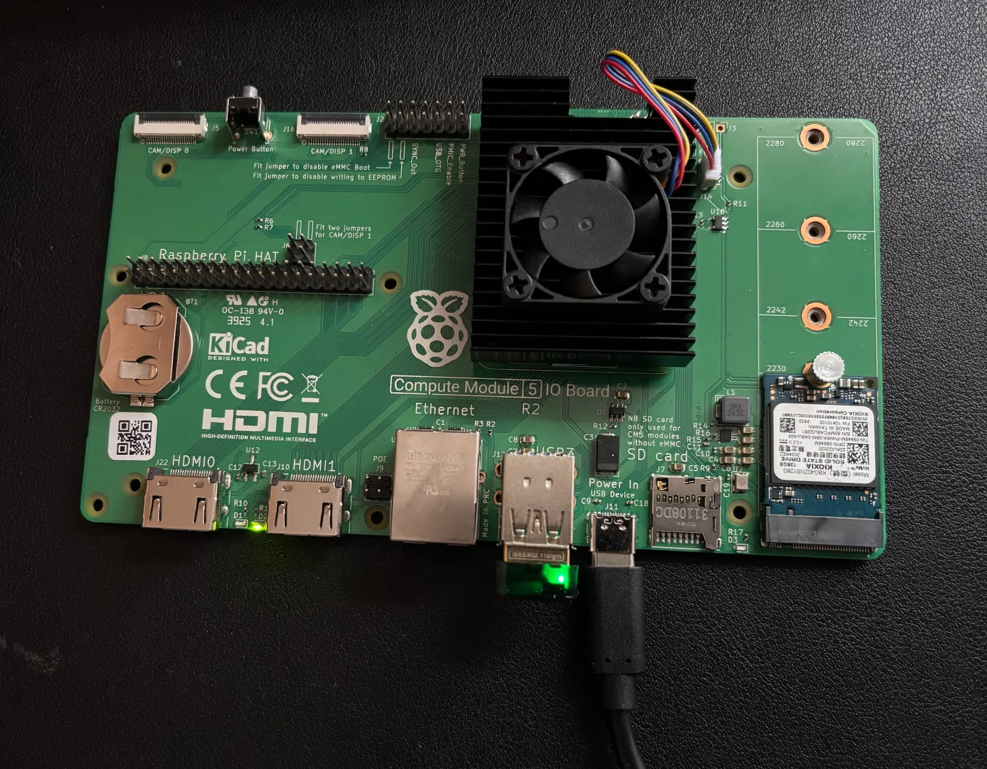
LISA Dataset Preparation
• 47 US sign classes narrowed to the 12 the car needs
• 6,097 cropped signs: 4,946 train / 567 validation / 584 test
• Frames of the same sign kept in one split to prevent leakage
• Every class is present in all three splits

Slide 4
GTSRB Test Results
gtsrb_test_results.json
{
"images": 12630,
"top1_accuracy": 0.9578780680918448,
"top3_accuracy": 0.9844813935075217,
"macro_class_accuracy": 0.9383357305447801,
"correct": 12098,
"incorrect": 532,
"per_class": { ... }
}
• 12,630 test images the model never saw during training
• 95.8% top-1: 12,098 correct, 532 incorrect
• 98.4% top-3: the right sign is in the model's top 3 guesses
• 93.8% macro: accuracy averaged across all 43 sign classes

Slide 5
Alexis Perez
Goals for the week
  Research different Vehicle Navigation Options
  Start OpenCV Course
Progress for the week
  Finalized/presented different Vehicle Navigation Options
  Completed OpenCV course
Goals for next week
  Research and buy any missing components (per Navigation Option)
  Continue OpenCV learning
Hours spent on progress
  7 hours.

Slide 6
Ethan Bishop
Goals for the week
  Test Pi HAT motor controllers on Raspberry Pi
  Integrate IMU on to Raspberry Pi
  Research 3D printing stl files for the chassis
Progress for the week
  Tested HATs for operational accuracy on Raspberry Pi
  Implemented IMU on Raspberry Pi
Goals for next week
  Research 3D printing stl files for the chassis
  Research possible ROS implementation
Hours spent on progress
  7 hours.

Slide 7
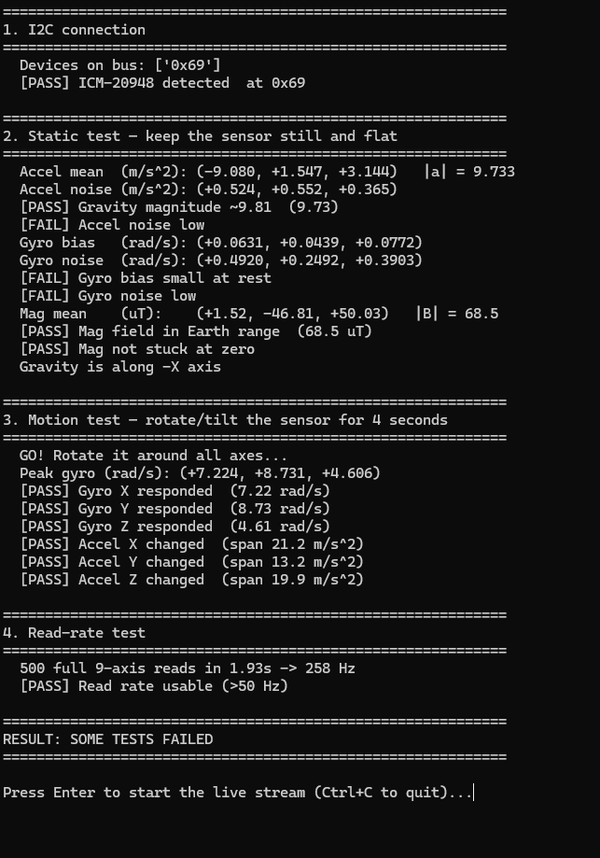
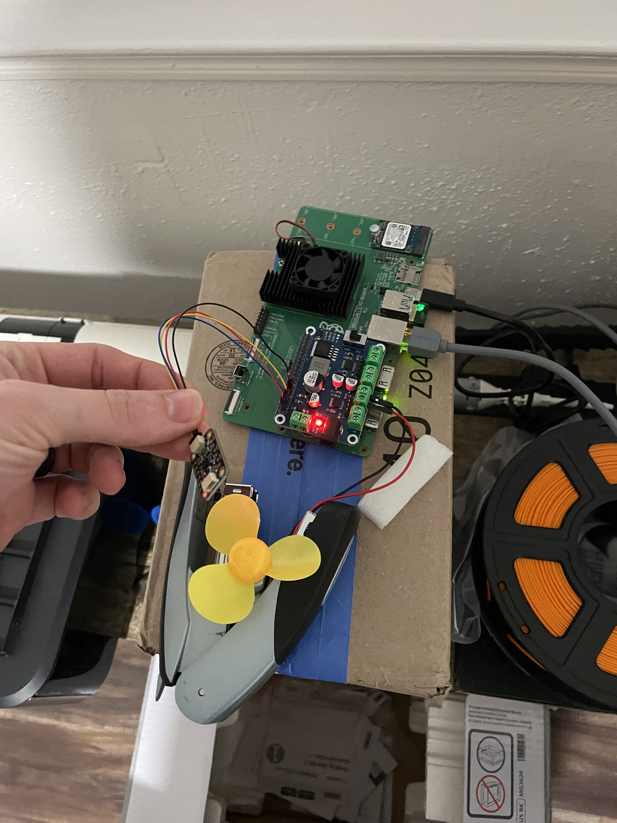
IMU Testing
Verified the measurements and directions that the IMU produced
Implemented IMU over I2C

Slide 8
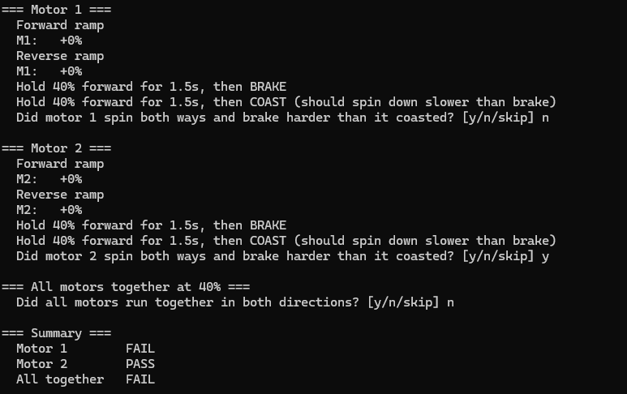
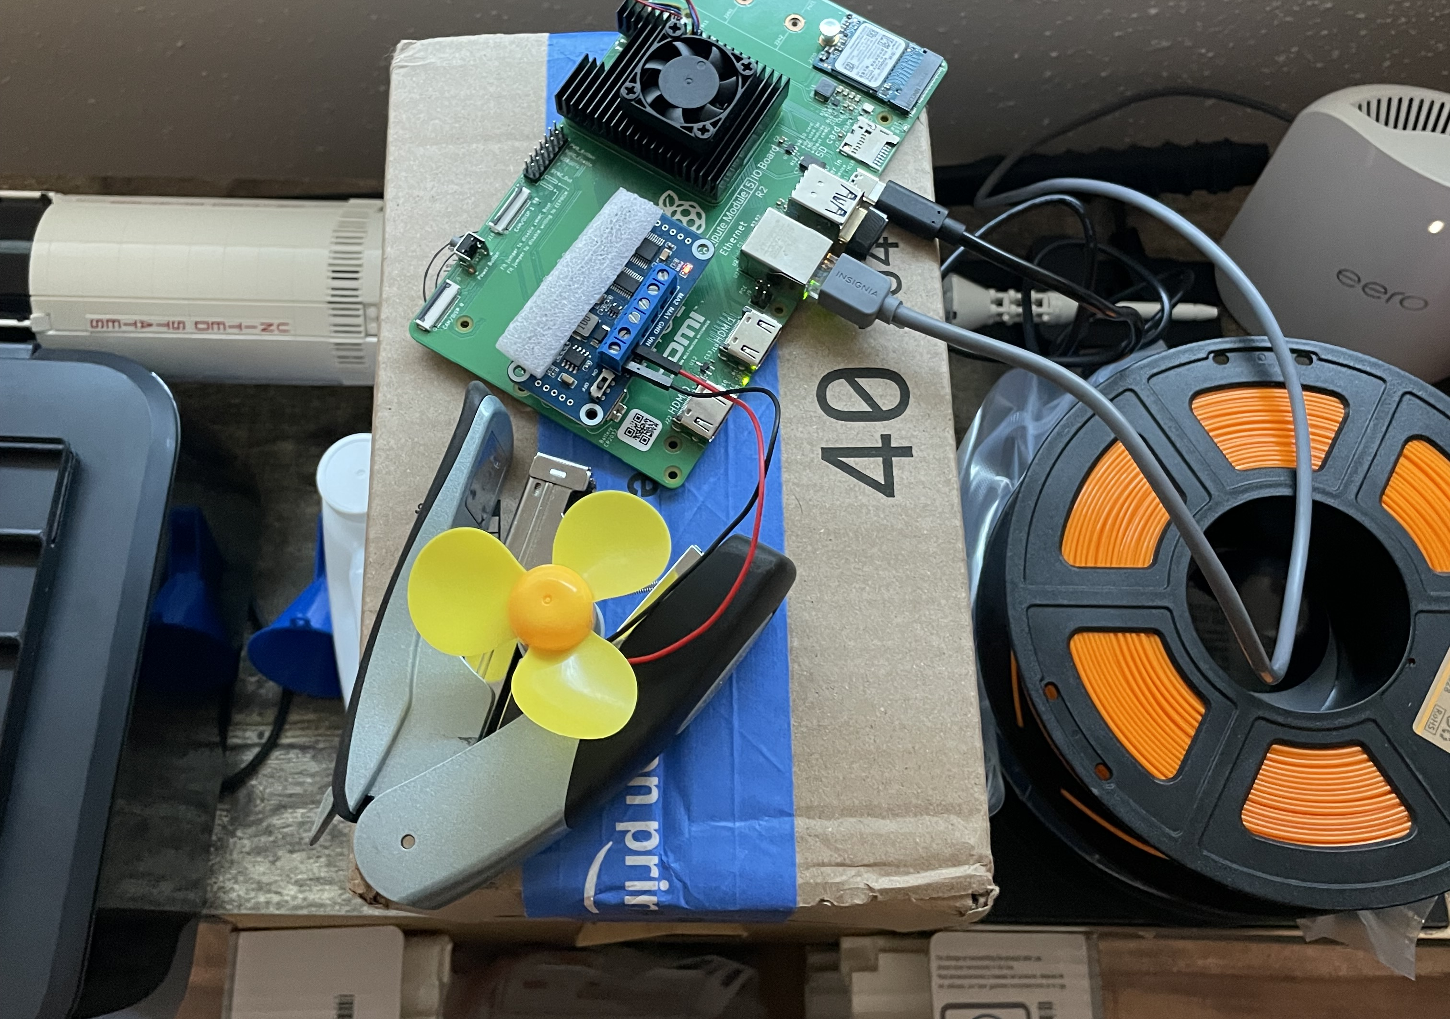
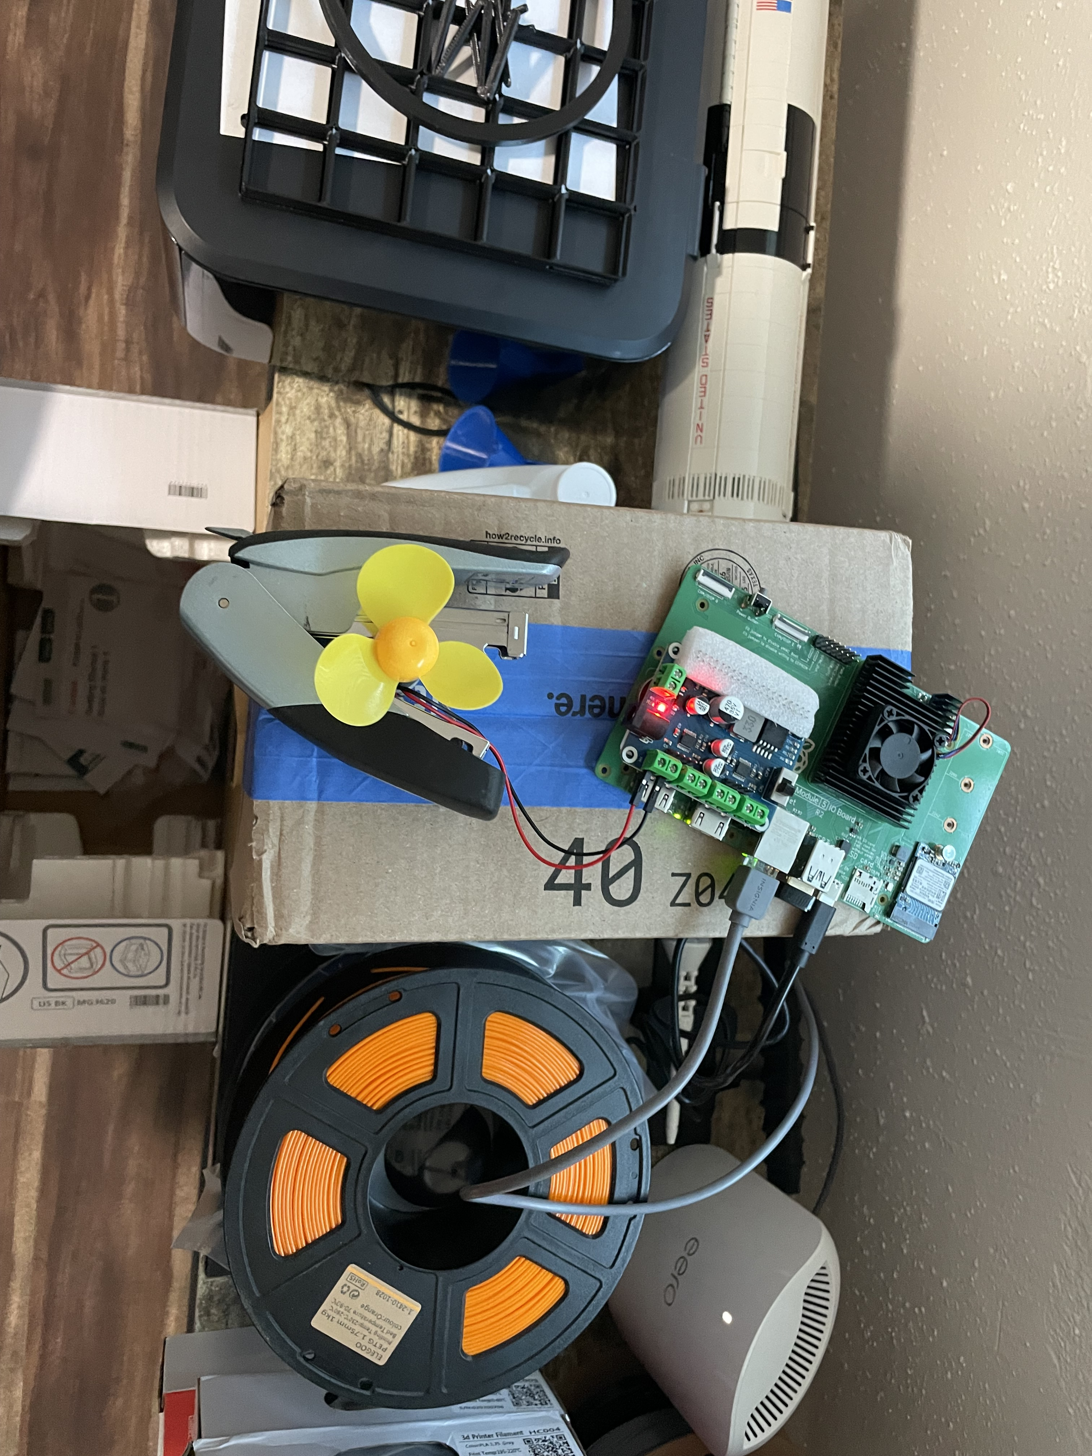
Motor Controller Testing
Tested the motor controller code for operational accuracy
Implemented both HATs over I2C on the 40 pin GPIO header

Slide 9
Abigail Duran
Goals for the week
  Continue hardware testing and verify communication between the Raspberry Pi and all connected components.
  Determine which components and connections will be included on the final PCB.
Progress for the week
  Successfully connect and communicate with the LCD and camera using the Raspberry Pi Compute Module 5.
  Integrate the LCD and camera with the machine learning model to display detected signs and corresponding commands.
Goals for next week​​​
  Begin planning the PCB layout, including component placement and board dimensions.​
  Begin planning power distribution and signal routing.​
Hours spent on progress
  6 hours​

